Slide 1
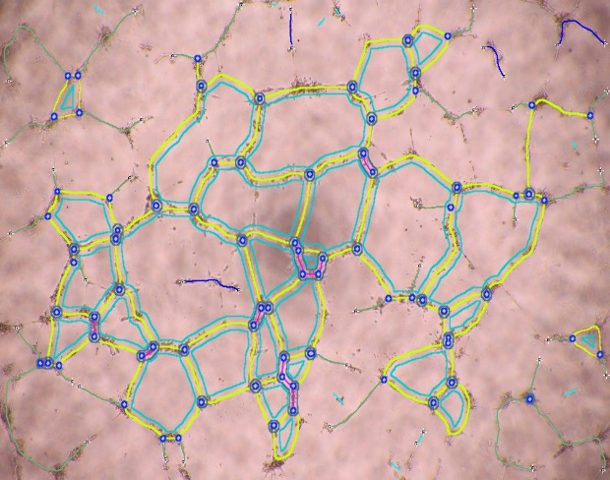
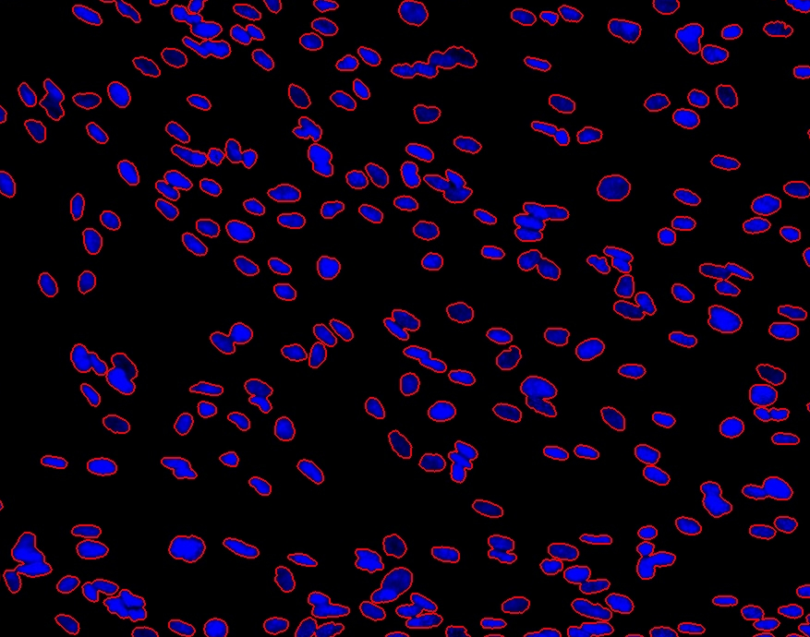
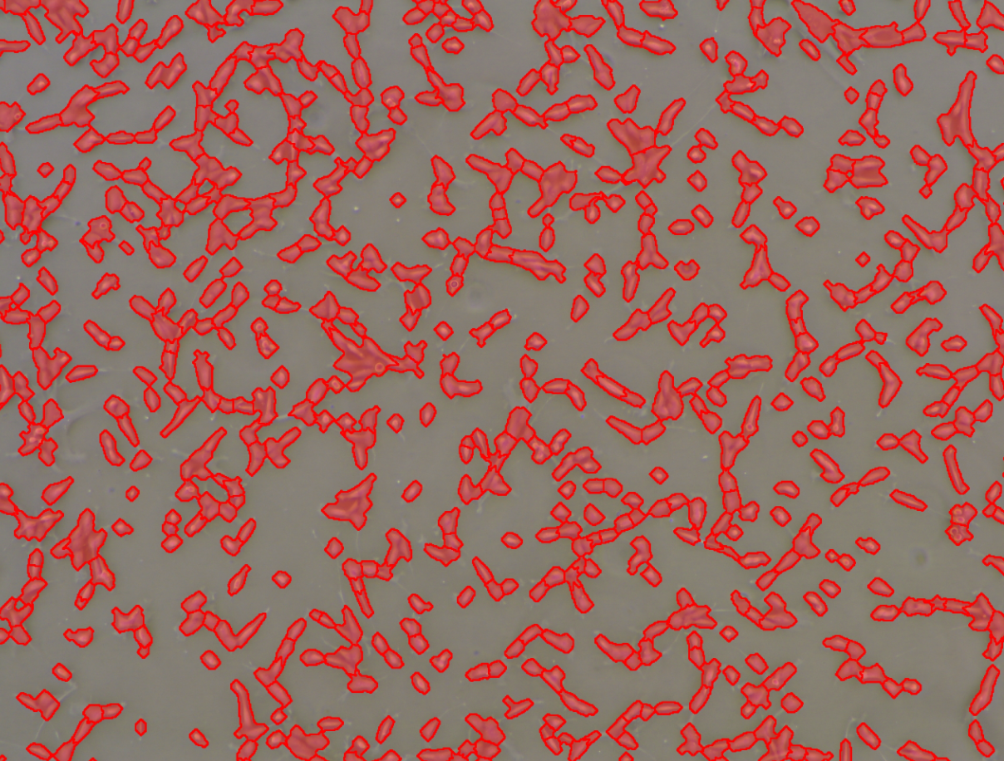
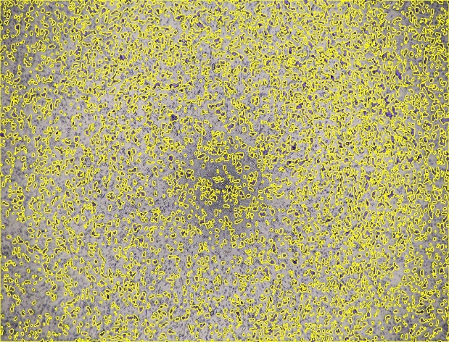
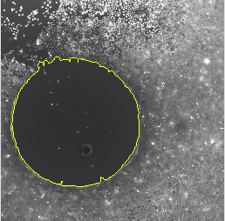
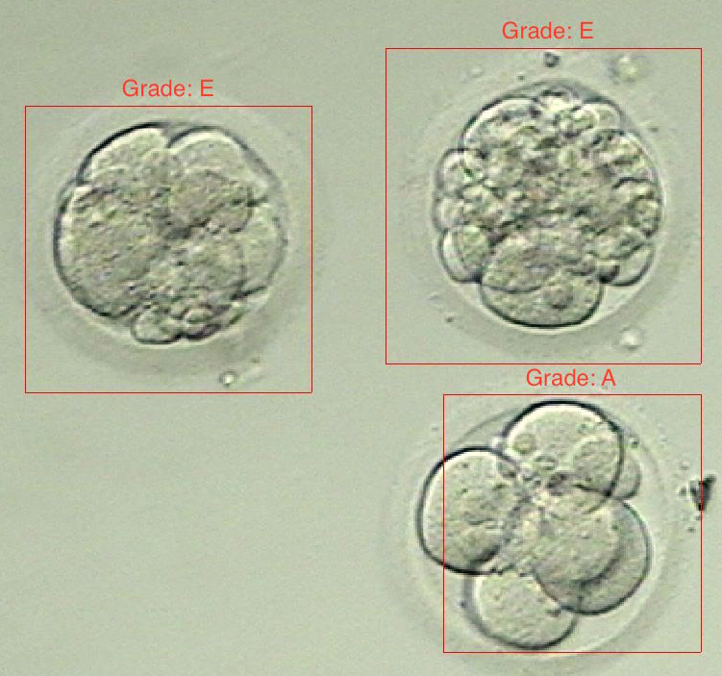
HiDOS Cell Cloud
27
436
26.32%
Cell A: Angiogenesis
Cell C1: Count
Cell C2: Confluency
24.96%
25.42%
Cell M1: Transwell Migration Assay
Cell M2: Migration
Cell S: Selection

